Slide 1
Washington University in St. Louis School of Medicine

Slide 2
Topics covered
GeneConnect Use Cases
GeneConnect Design

Slide 3
GC Use cases
Main Use cases
  Basic Genomic ID Search
  Query Based on Confidence score
  Query by Order of Node Traversal (optionally specifying link type)
  Query by Limiting Node Traversal
  Query by Limiting ID Frequency

Slide 4
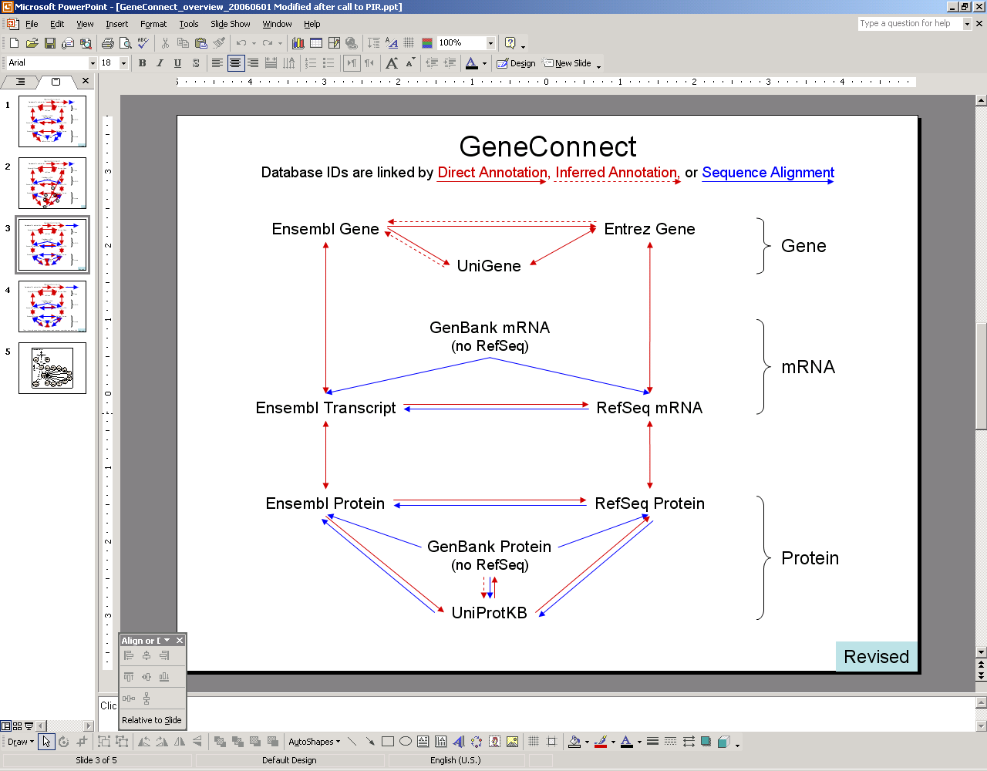
GeneConnect Graph

Slide 5
Basic Genomic ID Search
Search on one or more attributes within a gene, mRNA, or protein class and return results from that search as a list of objects of the same class
Input: Attribute (say) A1
Result set: as shown in table below
Entrez Gene ID | Ensembl Gene ID | Ensembl Transcript ID
A1 | B1 | C1
A1 | B1 | C2
A1 | B2 | C3

Slide 6
Query Based on Confidence score
Search on one or more attributes within a gene, mRNA, or protein class with a given or higher confidence score
Input: Attribute (say) A1 and confidence score (say) 0.50
Result set: The first row alone in the result set below, that satisfies minimum confidence score criterion.
Entrez Gene ID | Ensembl Gene ID | Ensembl Transcript ID | GenBank mRNA Accession # | Confidence
A1 | B1 | C1 | D1 | 0.65
A1 | B1 | C1 | D2 | 0.05
A1 | B1 | C2 | D3 | 0.2
A1 | B2 | C3 | D4 | 0.1

Slide 7
a) Query by Node Traversal
Search on one or more attributes within a gene, mRNA, or protein class and specify an order of node traversal.
Input: Attribute (say) A1 and order of node traversal (say) Entrez Gene -> Ensembl Gene -> GenBank mRNA -> Ensembl Transcript
Result set: The last row alone in the result set below, that satisfies order or node traversal criterion.
Entrez Gene ID | Ensembl Transcript ID | Ensembl Gene ID | GenBank mRNA Accession # | Confidence | ONT
A1 | B1 | C1 | D1 | 0.65 | A->B->C->D A->B->D->C
A1 | B1 | C1 | D2 | 0.05 | A->C->B->D
A1 | B1 | C2 | D3 | 0.2 | A->D->B->C
A1 | B2 | C3 | D4 | 0.1 | A->C->D->B

Slide 8
b) Query by Node Traversal – specify Link type
Search on one or more attributes within a gene, mRNA, or protein class and specify an order of node traversal as well as link types between pairs of data sources
Input: Attribute (say) A1 and order of node traversal (say) Entrez Gene -> Ensembl Gene -> Refseq mRNA -> Ensembl Transcript and link type (say) ‘Alignment-based similarity’ between Refseq mRNA and Ensembl Transcript etc.
Result set: Although rows 3 and 4 have ONT as ‘A->C->D->B’, but still the result set consists of only row 4 because the third row gets filtered out due to mismatch of link type.
Entrez Gene ID | Ensembl Transcript ID | Ensembl Gene ID | Refseq mRNA Accession # | Confidence | ONT
A1 | B1 | C2 | D3 | 0.2 | A->D->B->C
A1 | B1 | C1 | D1 | 0.65 | A->B->C->D
A1 | B1 | C1 | D2 | 0.05 | A->C->B->D
A1 | B1 | C2 | D5 | 0.1 | A->C->D->B (D->B linktpe is ‘Inferred annotation’)
A1 | B2 | C3 | D4 | 0.1 | A->C->D->B (D->B link type is ‘Alignment-based similarity’)

Slide 9
Query by Limiting Node Traversal
Search on one or more attributes within a gene, mRNA, or protein class and specify the nodes, to a subset of which traversal is restricted.
Input: Attribute (say) A1 and nodes (say) Entrez Gene, Ensembl Transcript, GenBank mRNA, Ensembl Gene
Result set: as shown in the table below
Entrez Gene ID | Ensembl Gene ID | Ensembl Transcript ID | Confidence | ONT
A1 | B1 | C1 | 1 | A->B->C A->C->B A->B A->C

Slide 10
Query by Limiting ID Frequency
Search on one or more attributes within a gene, mRNA, or protein class and specify the frequency minimum frequency.
Input: Attribute (say) A1 and minimum frequency (say) 0.5
Result set: First 2 rows of the table.
Genomic ID | Frequency
A1 | 1
B1 | 0.75
B2 | 0.25
C1 | 0.5
C2 | 0.25
C3 | 0.25
D1 | 0.25
D2 | 0.25
D3 | 0.25
D4 | 0.25
Entrez Gene ID | Ensembl Gene ID | Ensembl Transcript ID | GenBank mRNA Accession # | Confidence
A1 | B1 | C1 | D1 | 0.65
A1 | B1 | C1 | D2 | 0.05
A1 | B1 | C2 | D3 | 0.2
A1 | B2 | C3 | D4 | 0.1

Slide 11
GC Architecture Diagram
GeneConnect System Architecture
AnnotationParser Library
Download Data File using FTP, HTTP API
Public Data Sources
J O B M A N A G E R
Spawn new thread
Data Downloader Thread
Push Downloaded file in queue
Data file queue
Unigene
Consume downloaded File
Ensembl
Spawn new thread
Data Transformer Thread
Transformed data file
Parsed data file queue
Spawn new thread
Database Loader Thread
Consume parsed file
XMLRPC Server (for BLAST)
Write data to GeneConnect database
Gene Connect Server
Correlate Genomic Identifiers
Gene Connect Database
HTTP request
Web Server
Web browser
API
caCORE API
Java Apps
Objects
caGRID API

Slide 12
Design Steps
Data download, transform (create pair-wise link) and upload
Create all-to-all links
Query Interface
All the above design steps are explained in the notes below.
Notes:
Step 1 – Data download, transform (create pair wise link) and upload
JobManager class is the master controller class of all the proceedings. It spawns multiple threads for downloading, parsing and data loading.
The downloader threads download the data from different data sources and copies the data on the local machine.
The transformer threads can be simple parsers for the data downloaded or can be components like BLAST for sequence alignment operations.
The transformers process the downloaded files and obtain pair-wise mappings between data sources for each genomic identifier in each data source, by parsing the data files. For each data source a correlation table is created to store mapping information.
The transformers can either directly load the output into the database or into text files which can then be loaded using the database loader threads.
Transformers can be written in any programming language and can be plugged into the framework without any code change to the annotation server.
High throughput sequence alignment is performed on clustering using an XML RPC server. The output of this sequence alignment is then stored in text files which is transferred back to the annotation server.
Dataloader threads upload the data into text files using high throughput load mechanisms like Oracle SQLLoader.
Step 2 – Create all-to-all links and Order of Node Traversal (ONT)
Once all the data is downloaded, processed and uploaded into the database, the next step is to calculate all possible traversal paths from one data source to all the other data sources and stores this information in a table.
Using pair-wise links created by the transformers, the all-to-all link containing all possible combinations of genomic identifiers for all paths and the order of node traversal (ONT) is calculated.
Step 3 – Query interface (API and web application)
Provides a caCORE like API and caGRID API which takes in any object in the GeneConnect UML model and returns any object in the model. The user can traverse the UML model using the associations within the model. These APIs run within a web server. User can call these APIs from a standalone application. These APIs are also internally used when the user makes a request through the browser.
Users can specify the desired order of node traversal and the type of link for each pair of genomic identifiers (annotation, inferred annotation, exact match, inexact match).
A web interface will be built using the caCORE APIs which will allow users to perform the all the important use cases.

Slide 13
Summary table creation
Calculate path metadata
  Involves calculating all possible paths from a given data source to all other data sources. The input to this is the GeneConnect graph.
Populate summary tables
  Uses the base tables (which contain links between a pair of genomic IDs, one from each data source).
  Uses the path metadata calculated above.
  Creates a summary table with schema shown in following slide.

Slide 14
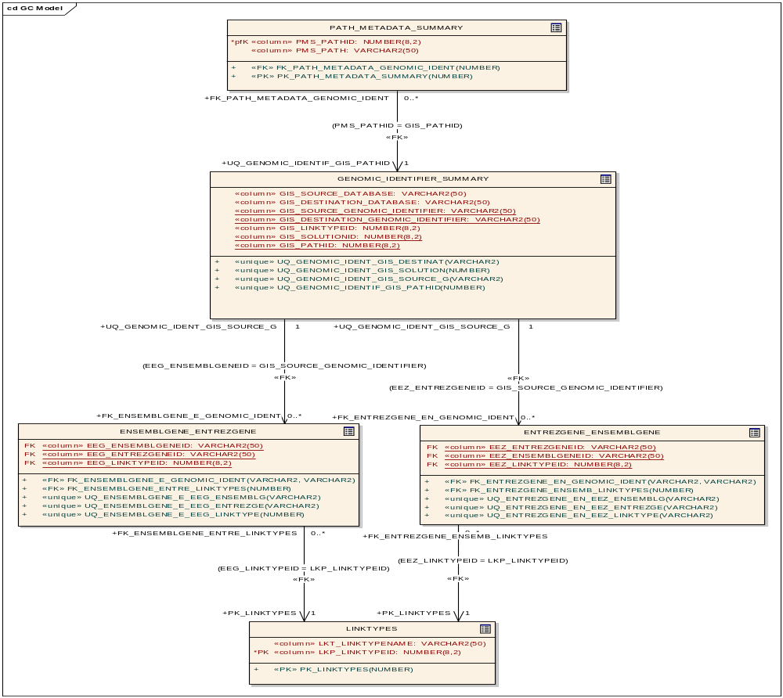
Summary table population - Example

Slide 15
Query Interface
caCORE like API
  User will populate the GeneConnect application domain object and call the application’s caCORE like API’s ApplicationService.search() method, also specifying the return type object.
  caCORE APIs will be modified/extended to implement the business logic specific to GeneConnect. The business logic includes obtaining pre-calculated paths from meta-data table, calculating all-to-all paths and search for genomic identifiers along the path in summary table, and calculating the confidence and frequency values (explained below).
  Both confidence and frequency will be calculated dynamically on the result set of genomic identifiers obtained and will not be stored in the database tables. A list of result objects is returned to the user.
Web Interface
  Calls the caCORE API’s internally to get the results of user query.

